Slide 1
Analysis of JustEatTakeaway with social media data analysis
by Eran Kan Kohen (523228)
**References available in speaker notes below relevant slides

Slide 2
1. Business Analysis
Desk Research & Introduction to JustEatTakeaway

Slide 3
Introduction to JustEatTakeway
Food Delivery App → “Connecting Consumers to Local Restaurants”
The app or the website facilitates the communication between the consumer and the restaurant
It is a combination of two European companies, established in 2020.
The company generates revenue through order commissions
JET operates in 20 countries, in 4 continents, with 65 million users.
Notes:
https://www.businessofapps.com/data/just-eat-statistics/
https://www.justeattakeaway.com/our-markets
https://www.justeattakeaway.com/what-we-do

Slide 4
Competitors of JustEatTakeway
Symmetric
Deliveroo → Recently closed in NL, UK-based, delivers food and groceries, assisting restaurants opening delivery-only kitchens
Uber Eats → Under the huge Uber brand, US-based, delivers food, innovated early with scheduled orders and delivery tracking
Getir/Gorillas → Recently joined, Europe-based, delivering groceries in NL, Getir delivers from local smaller markets and has implemented additional services such as ordering food, calling a taxi, and renting a car in Turkey
TooGoodToGo → Food-waste prevention initiative, Europe-based, assists restaurants to sell soon to be expired food and customers to buy for less
Supermarkets (ex. AH/Jumbo) → Supermarkets offer both food delivery and purchase from stores, constantly innovating with personalized discounts and competitively priced groceries, trying to create an experience
Restaurant Chains (ex. Dominos/McDonalds) → Several restaurants have their own apps to order food directly from the restaurants, can only be used to order from the specific restaurant, offer premium discounts and loyalty points
Asymmetric
Notes:
https://deliveroo.nl/en/
https://deliveroo.co.uk/about-us
https://www.uber.com/en-TZ/newsroom/ubereats-tech-update-2/
https://about.ubereats.com/nl/en/?_ga=2.158131449.2120831733.1670864377-660897172.1670864377
https://getir.com/hakkimizda/
https://gorillas.io/en/manifesto
https://vigourtimes.com/grocery-delivery-firm-getir-acquires-embattled-rival-gorillas/
https://toogoodtogo.com/en-us/movement/education/faq
https://toogoodtogo.com/en-us/business
https://www.jumbo.com/boodschappen-bestellen/thuisbezorgen
https://mopinion.com/albert-heijn-caters-to-online-shoppers-with-customer-feedback/
https://www.dominos.nl/app
https://www.mcdonalds.com/us/en-us/about-us.html

Slide 5
JustEatTakeway Data Analytics
Effective collaboration and communication with different teams like marketing, enabling better and unanimous decision making → Center of Excellence
Focus on pillars of “customer experience, logistics, internal”; JET uses data on its primary ways of offering a premium service to restaurants and customers
Circular analysis loop where the results and analysis of previous campaigns feed into the new one, retaining insights and pieces of information
Different teams and various ways of working to provide flexibility to retain and best-utilize employees from different backgrounds
Constant feedback to optimize results, and greatly improve teamwork

Slide 6
2. Twitter Strategy
Commonly used words and sentiment scores

Slide 7
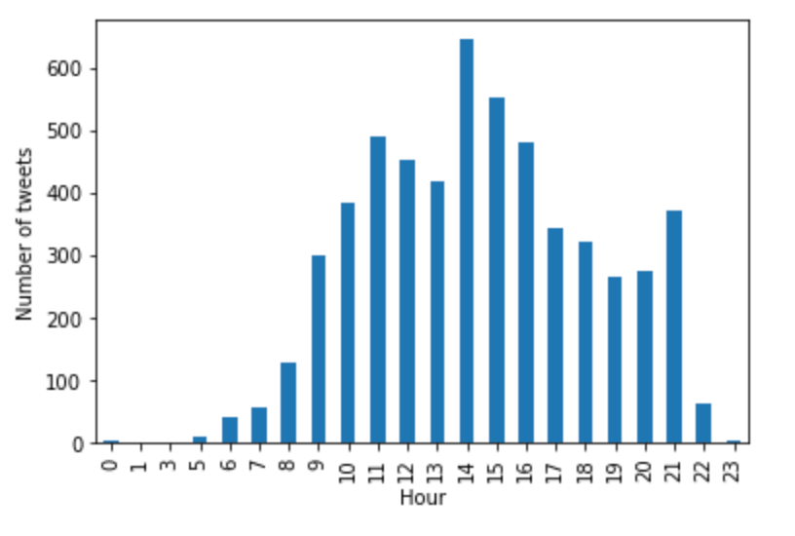
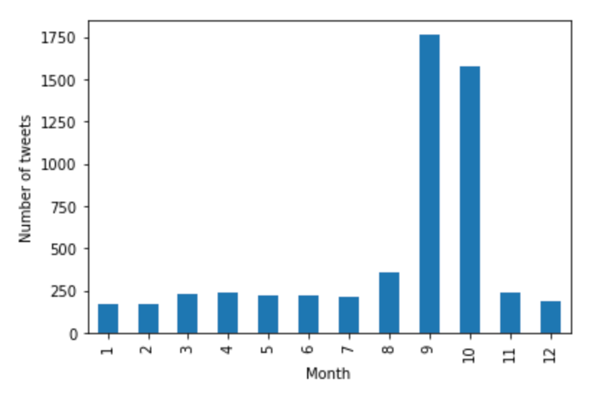
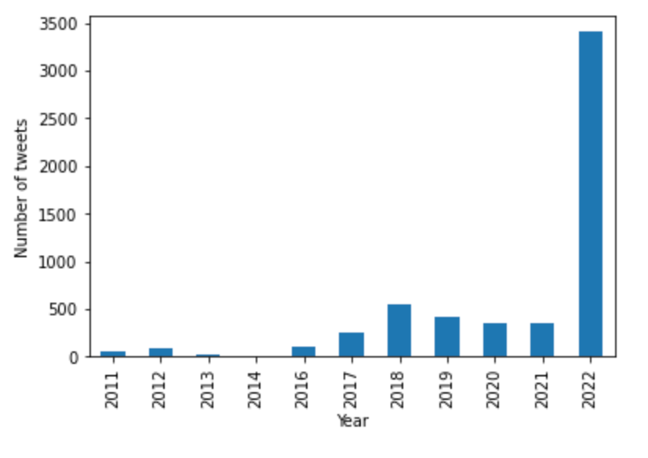
The Most Common…
Words:
DM, Look, Order, Like, Hey
Not a lot of meaning to most of the words
DM indicates that most tweets are about contacting individuals
Bigrams:
DM Order, Order Number, Drop DM
Mostly about contacting individuals (DMs)
Possible inquiries about orders (Order)
Trigrams:
DM Order Number → tracking individual orders
Take Closer Look → investigating the topic in hand
Email Twitter Com → contacting someone via Twitter
Timing:
Active during September and October, almost the same rate in other months
Active between 11:00-16:00, almost no activity between 23:00-07:00
More tweets in 2022 than the previous years combined
*Before the analysis was conducted the initial dataset was prepared. Stopwords were removed from the data, links, meaningless words and letters were removed from the corpus. Stemming was used to make sure words were turned into their roots, making this and further analyses much easier and accurate

Slide 8
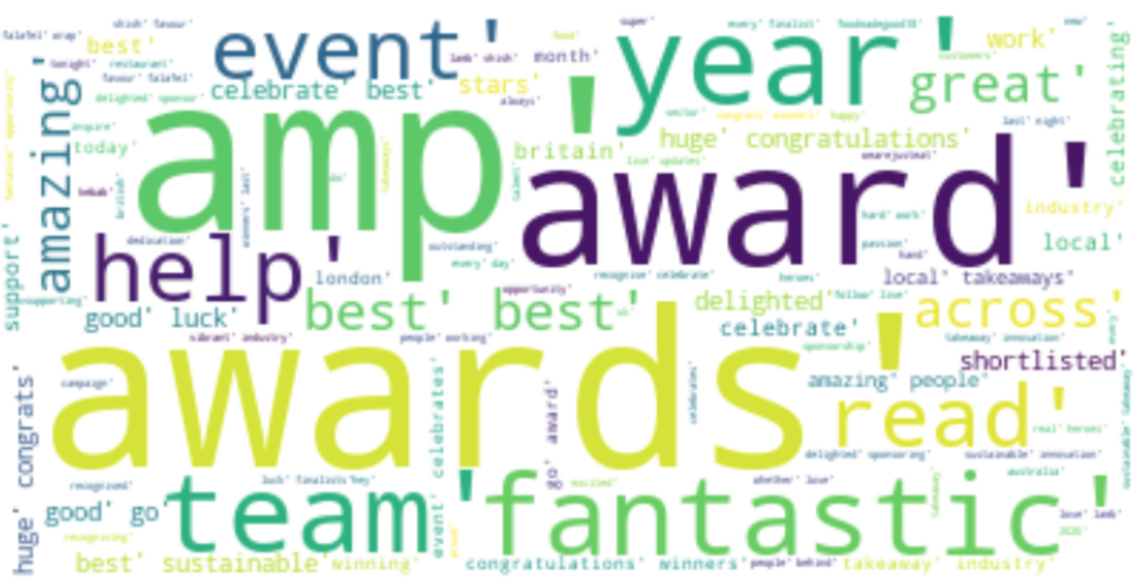
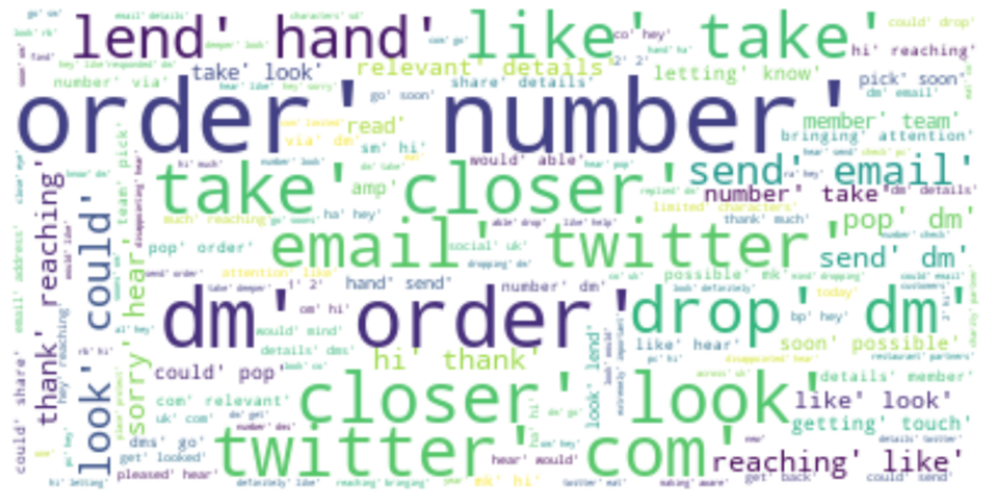
Sentiment Scores
General Sentiment:
More than 95% of tweets have a slightly positive or neutral tone (0,1,2)
Very few tweets have a negative or extremely negative tone (-1,4,5,6)
Commonly Used Words in…
Positive Tweets:
Awards, Year, Team, Best, Celebrate, Fantastic
Most of them seem to be about success of the company
Negative Tweets:
Order, DM, Number, Drop, Take, Closer, Look
Most of them seem to be about issues regarding individual orders and JET investigating the issues

Slide 9
3. Engagement Analysis
People adapt their lives according to what they see/hear on TV

Slide 10
The Engagement Rate
Outcomes:
Positive tweets are better for engagement
Both negative and positive tweets can be retweeted a lot (depending on the number of replies)
Likes:
2.1 slope positive relationship
Higher sentiment leads to higher number of likes
Positive tweets tend to get liked more
Retweets:
0.25 slope positive relationship
Higher sentiment leads to more retweets (slightly)
People like sharing positive news
Replies:
Almost no relationship
The tweet being positive or negative does to affect the number of replies
Complex (All variables used to predict one):
High likes achieved by more replies and positive tweets
Higher number of retweets is correlated with less replies and negative tweets
The number of replies can’t be predicted when all variables are in a model

Slide 11
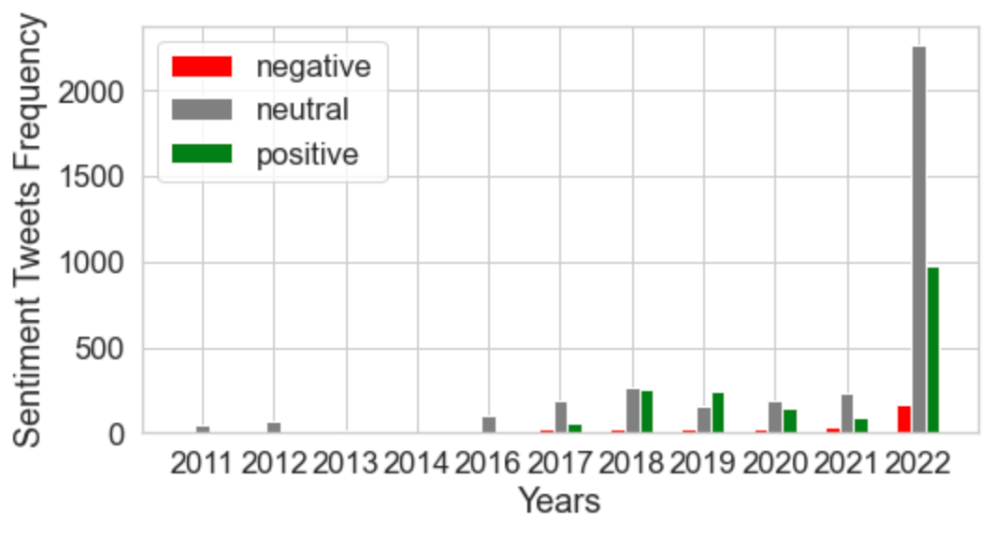
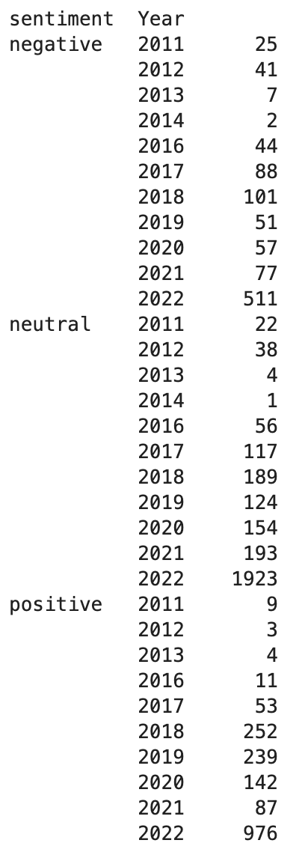
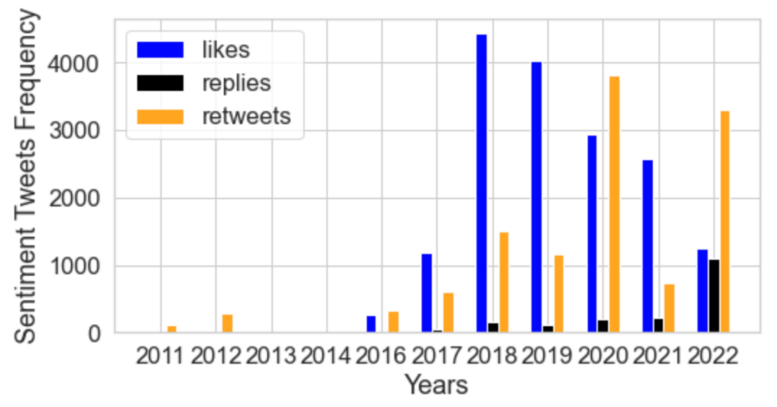
The Engagement Rate over Time
Pre-Post COVID-19
Until COVID-19, more positive tweets were being sent, very few negative ones were sent
Since COVID-19, most of the tweets are fairly neutral
The number of tweets have skyrocketed in 2022
Number of likes decrease A LOT
The number of tweets do not correlate to higher number of likes
Weird considering that even though the rate of sentiment changed, the number of tweets in each sentiment category is highest in 2022 but has the lowest number of likes since 2018,
2022 (Year of Mystery)
Something is not right in 2022
The number of likes had been decreasing since 2018 but do not see an increase even though the number of tweets increase a great deal
The number of replies increase a lot
Retweets
Huge increase in 2018 with the increase of likes
Another huge increase in 2021 and 2022

Slide 12
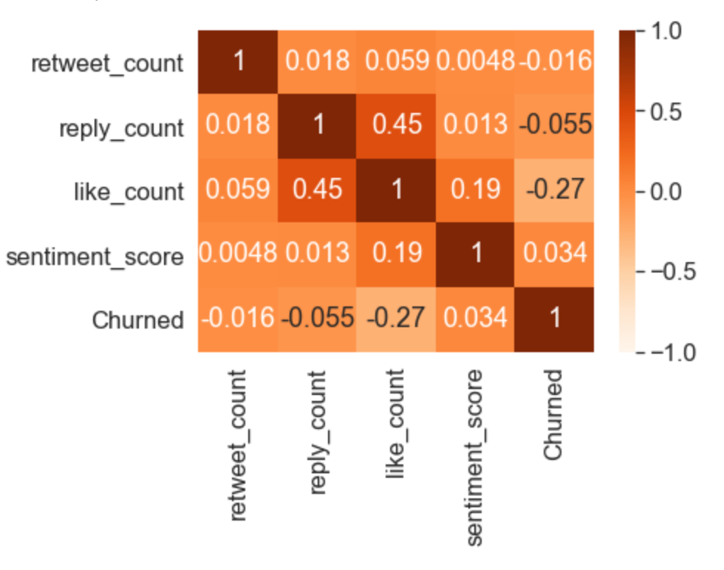
Customer Churn vs Engagement
Engagement metrics and churn do not correlate a lot →
Like count seems to have a very little negative effect on churn which is very positive
It indicates that having tweets with more likes leads to less churn
This adds a substantial reason to focus on Twitter besides building a better brand image
Better Twitter strategy leads to greater number of likes
Greater likes lead to greater customer retention
The same heatmap was created separately for 2021 and 2022 with no massive difference
Almost no correlation between any variables for both years
It shows that the lack of correlation is constant

Slide 13
4. Innovation Areas
How JET tweets about specific innovation areas

Slide 14
Innovation of Sustainability
Increased customer satisfaction and loyalty: Consumers may be more likely to use JET if they perceive the company as being more environmentally-friendly.
Improved reputation:JET could improve its brand image and reputation. Consumers may view the company as more socially responsible and values-driven.
Increased partnerships and collaborations: JET can form new partnerships with other companies and restaurants that are also focused on sustainability. This could lead to increased exposure and credibility for JET, and potentially attract more customers to the platform.
Reduced operating costs: Implementing sustainability initiatives can often lead to reduced operating costs, as companies may be able to save on resources such as energy and water. This could lead to increased profitability for JET.
Overall, innovation concerning sustainability initiatives can lead to both same-side and cross-side network effects for JET.

Slide 15
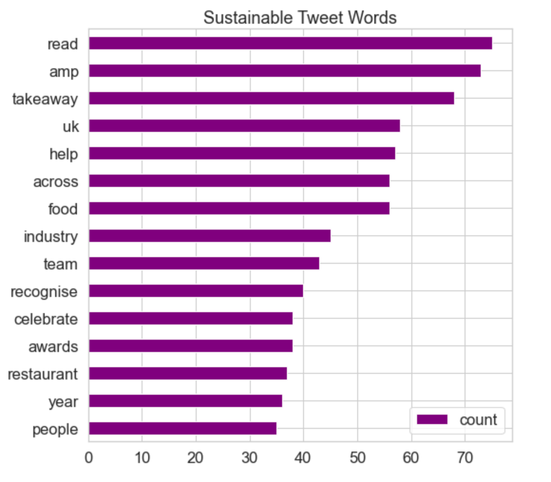
Words in Sustainability Tweets
Tweets which concern sustainability have positive words like “team”, “help”, “recognise”, and “celebrate”
The usage of the word “UK” possibly indicates that the sustainable efforts are focused in the UK
The words “awards” and “celebrate” indicates an achievement in the area of sustainability which JET is sharing with the general public
Most tweets in 2018 in the months of March and November
Overall, it is clear that JET is pushing for a positive sustainable narrative when tweeting with words such as “eco-friendly” or “sustainable”

Slide 16
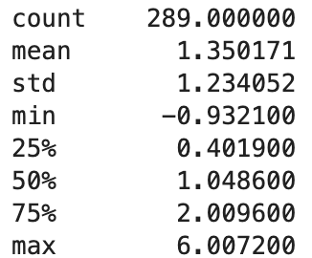
Engagement/Sentiment ~ Sustainability
Sustainability generates a lot of likes (5.9 slope) and generally have an higher (0.6 slope) sentiment score
It has a small positive effect on retweets (0.5 slope) and an almost nonexistent influence on replies
This indicates that tweets concerning sustainability is generally appreciated by the public with no increase in the amount of issues
Almost all of the tweets have a neutral/positive weight, with the maximum value reaching a very positive sentiment

Slide 17
The Engagement Rate with Sustainability
Likes:
2.1 slope positive in general
5.9 slope positive in sustainability
Retweets:
0.25 slope positive in general
0.5 slope positive in sustainability
Replies:
Almost no relationship in general
Almost no relationship in sustainability
Conclusion
For every metric, sustainability either performs better or keeps it constant
Sustainability should definitely be a part of the Twitter strategy much more than it actually is, it leads to positive results
Currently sustainable tweets cover a small part of the tweets of JET

Slide 18
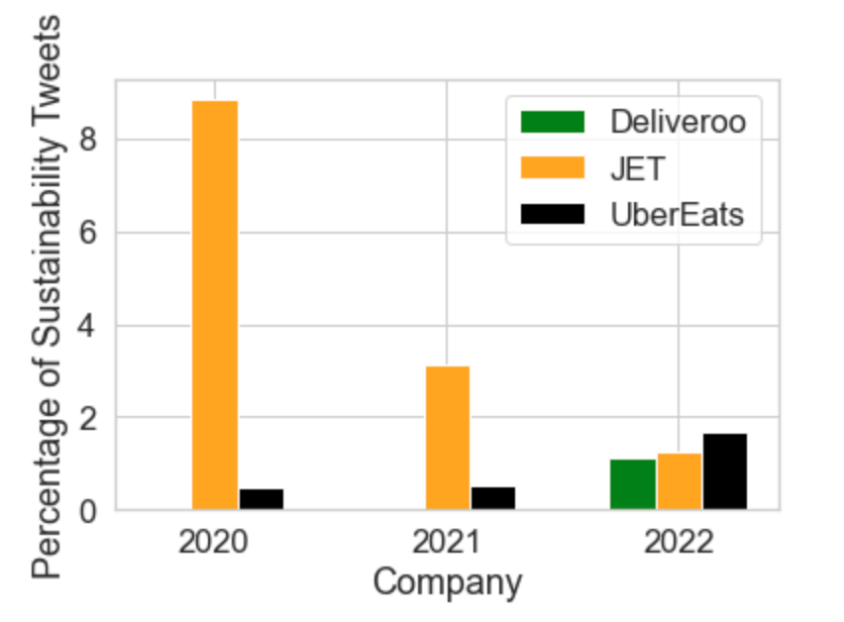
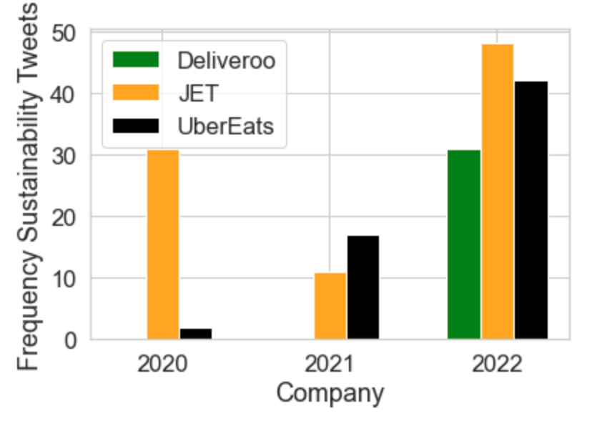
Competitors in Sustainability
The two main competitors available are UberEats and Deliveroo
In 2020, JET outperformed both companies easily by tweeting much more about sustainability
In 2021, UberEats started tweeting much more about sustainability compared to JET but since they tweet much more in total, JET still had a higher percentage
In 2022, Deliveroo started tweeting about sustainability, with all of the companies tweeting a record number of times about sustainability
Since JET started much more in general, the percentage saw a decrease, making it fall behind UberEats
These graphs indicate that JET was a trend setter in terms of focusing on sustainability on Twitter, with both UberEats and Deliveroo following in their footsteps

Slide 19
5. Conclusion
Wow. So much information…
Let’s summarize!

Slide 20
Conclusion
Limitations & Possible Improvements
Context is missing from most of the Tweets
The analysis only looks at the words in a tweet to categorise its sentiment score as well as if it fits in the innovation strategy
Some Tweets might not even be about JET
An improved method of clustering Tweets could be used
Self reflection bias
The people active on Twitter may not reflect the entire sample
Tweets might not be representative of most of the users that use JET
External factors could have influenced
Social media algorithms could have influenced the engagement of the Tweets for unexplained reasons
Specific events could have led specific Tweets performing much differently, affecting that month or year’s performance for an unexplained reason, affecting the correlation

Slide 21
Field Study
Select a group of participant
Similar to doing A/B testing, two groups will be selected and some will be shown Tweets and News articles about sustainable innovation at JET, the other group will not be shown these pieces of information
Measure the impact
Both groups will be tested through surveys or their purchase intentions will be monitored for some time in the future. Their behavior or intentions (depending on survey or monitoring) will indicate if the group who received the sustainable news will act differently than the other group
Analyse the results and make predictions
After seeing the behavior of both groups, JET can see which other variables (such as age or income) can act as confounders or moderators in the relationship to understand which groups of people they should target when promoting sustainable innovations
JET could also improve the study by showing a group of people Tweets limited engagement and another group Tweets with a lot of engagement. The relationship which is explored above might affected by customers seeing engagement

Slide 22
Thank you
for your attention!

